Slide 1
Neural Networks Part 3
Kevin Sim
Slides courtesy of Prof. Emma Hart

Slide 2
RECAP
Last week we looked at supervised learning using a multi-layer perceptron for classification
Backpropagation
Finds a set of weights that gives good performance
Requires training data: input and output pairs
Iteratively reduces error at the output neurons
For some applications:
Hard to generate the required training data (pairs)
We don’t know what the output should be

Slide 3
Overview
Unsupervised learning using NN
Training a neural network with an evolutionary algorithm
i.e. use EA to find a set of weights
Applications of this:
Robot control with a neural network
NEAT: evolving topology & weights of a network with an EA

Slide 4
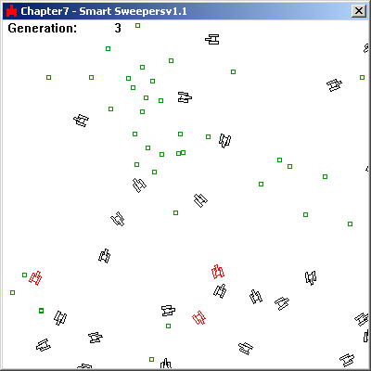
An Example: Minesweeper
Objective is to collect mines
Neural network controls the movement of a “robot” (minesweeper)
From last week we know a NN requires inputs and outputs
Inputs are sensory information obtained from the environment
Output is direction of movement
NN Controller is trained to direct the minesweeper towards mines

Slide 5
An Example: Minesweeper
Objective is to collect mines
EA used to evolve weights for the NN controller
EA Requires a representation (chromosome genotype) and fitness function (more later)
Example: Natural Motion
https://www.youtube.com/watch?v=ySRvKzZsDqw

Slide 6
Minesweeper: Inputs
In robotics, inputs obtained by sensing the environment
In real-robots, could be infra-red, acoustic, video etc.
In simulation, we can ‘sense’ distance to an obstacle

Slide 7
Minesweeper: Inputs
What information does it need ?
Minesweepers position (x,y)
Position of closest mine (x,y)
Vector representing the heading (x,y)*
6 inputs in total
(x,y)
Closest mine
(x,y)
Look-at
Assume vectors relative to origin so defined by 2 values

Slide 8
Minesweeper: Inputs
Could use 6 inputs: But
Fewer inputs: fewer weights
Fewer weights: faster training
Faster training: faster network
(x,y)
Closest mine
(x,y)
Look-at

Slide 9
Minesweeper: Inputs
Actual positions don’t matter
The relative direction between the mine and the current direction does
Input can actually be represented by 2 vectors
This only requires 4 inputs:
(x,y) for each vector
Closest mine
Look-at

Slide 10
Minesweeper: Inputs
NN require normalised data
Good idea to standardize inputs:
Look-at vector is normalised to be of length 1
Closest-mine vector might be very large
We can normalize this too
Both inputs then have similar emphasis
Actual distances and directions aren't important just relative difference between look at and closest mine
Closest mine
Look-at

Slide 11
Minesweeper: Outputs
The rotation and velocity are adjusted by activating one or both of the left and right tracks
The NN needs two outputs:
Left track
Right track
Rotate by moving one track

Slide 12
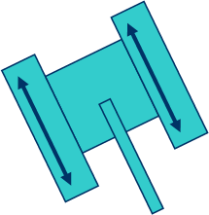
Minesweeper: Outputs
The rotation and velocity are adjusted by activating one or both of the left and right tracks
The NN needs two outputs:
Left track
Right track
Move forward by activating both tracks

Slide 13
Digression:
When we talked about simple perceptrons we used a step function that output 0/1
More useful to have a neuron that can output any value
Probability
Distance
Angle
Step Function:
Output value
1
Threshold T
-2 -1 0 1 2
Activation value (weighted sum of inputs)

Slide 14
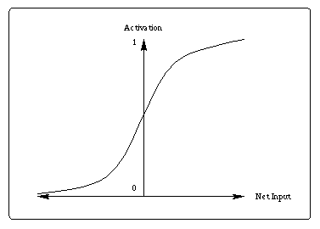
Threshold Functions
Rather than a step activation function, it would be better to have one that varied:
Smoothly
Continuously
Why ?
Can output a whole range of values
There is no abrupt change from one value to another
Imagine a car engine control system that allowed only 0 or maximum power
output
Input to neuron

Slide 15
Minesweeper: Outputs
The rotation and velocity are adjusted by adjusting the relative speed of the left and right tracks
The NN needs two outputs:
Left track speed
Right track speed
Smooth transition from 0 (off) to 1 (maximum)
Allows the robot to turn while moving position

Slide 16
Threshold Functions
There are lots of mathematical functions that might work
This one is called a sigmoid function
Varies between 0 and 1
Shape can be ‘flattened’ if required
It is define as:
output
Input to neuron

Slide 17
The Sigmoid Function
a is the weighted sum
e is a mathematical constant 2.7183
p is a user controlled parameter usually set to 1
(by changing p we can ‘squash’ the curve)

Slide 18
The Minesweeper Neural Net
Left track
Right track
OUTPUT
HIDDEN LAYER
Look-at vector
Closest-mine vector
INPUTS
We need to assign each weight so that the network outputs the correct values for any set of possible inputs

Slide 19
Calculating the weights
In this case, there are 72 weights to find
For backpropagation, we need training data with input-output pairs:
Hard to obtain for this type of application:
Another approach to training is to use an Evolutionary Algorithm to evolve the weights
A chromosome (length= number of weights) represents the weights in neural network
w₁
w₂
w₃
……………
w₇₁
w₇₂

Slide 20
In-Game Training with an EA
An EA needs a representation
Use floating point values, one for each weight we need
and a fitness function:
Allow the game to run for some number of frames
Monitor how many mines each sweeper found
-0.1
0.3
0.6
0.4
……..
-0.8
Fitness = number of mines found in fixed time frame

Slide 21
The Flow of Control
A population
of minesweepers
each with a different
NN runs for X iterations
of simulation
Record fitness of each
minesweeper
Load new chromosomes
defining weights back into
the NN of each sweeper
Run EA for 1 generation
to evolve a new set of
chromosomes (each defines
a set of NN weights)

Slide 22
Training with an EA
Chromosome 1 (NN1)
Chromosome 2 (NN2)
Chromosome 3 (NN3
0.1 0.3 0.5….0.3
EA population
Chromosome represents weights of a neural network

Slide 23
Flow of Control
Initialise a population of minesweepers each with its own neural network and its own chromosome representing the weights
Weights initially set to random values
While number of generations < maximum generations
Run game (for a set amount of time)
Record how many mines each sweeper detected
Assign this value as the fitness of its chromosome
Run the EA to evolve a new population of weights
Apply selection, crossover, mutation
Insert new weights into each minesweepers NN
Repeat ….

Slide 24
Evolutionary Algorithm
Generational EA (whole new generation produced each iteration)
Differs from the steady state EA where typically 1 or 2 children are generated each generation
Generation
BEST Chromosome 1
BEST Chromosome 1
Chromosome 2
Copy best chromosome to new population (elitism)
Child Chromosome 2
Chromosome 3
Child Chromosome 3
.
.
.
.
.
While newPopSize < popSize
Generate child
Selection
Crossover
Mutation
Insert Child (no replacement)
Repeat
.
.
.
Chromosome N
Child Chromosome N

Slide 25
Evolutionary Algorithm
In each generation:
Create new empty population
Copy best chromosome from current to new population (elitism)
Repeat until new population full:
Select two parents with roulette wheel selection from current population
Apply crossover to produce new child(ren)
Apply mutation to new child(ren)
Add child(ren) to new population
New population becomes current population

Slide 26
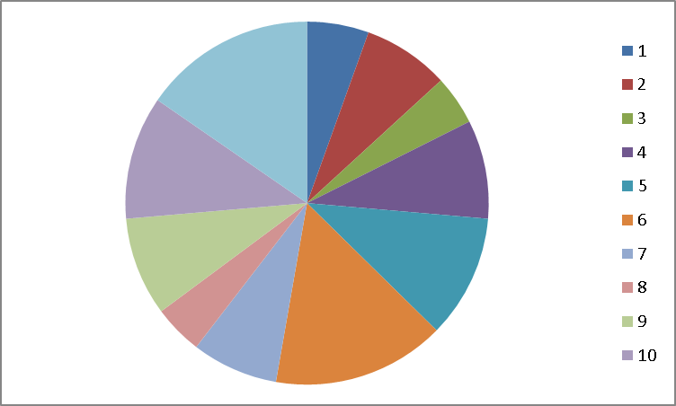
More details on the EA
Selection:
Selection pressure is as a result of the selection stage only
No replacement stage in a generational EA
Best chromosome (could be more than 1. i.e. best 2) copied to new population each generation (elitism)
Common to use Roulette Selection
Selection probability proportional to fitness

Slide 27
More details on the EA
Crossover:
Any kind of crossover will produce legitimate chromosomes (1pt etc.)
Two point or uniform crossover will work just as well
0.1
-0.4
0.9
-0.2
0.7
0.2
0.1
-0.4
0.3
-0.5
0.1
0.1
0.5
0.1
0.3
-0.5
0.1
0.1

Slide 28
More details on the EA
Mutation
Adds or subtracts a small value from each gene
Probability of mutation
Random number between -1 and 1
for (int i=0;i<chromoSizel;i++){
if (randFloat < mutationRate)
chromo[i] += randomClamped()*maxPerturbation;
}
Fix max size of change

Slide 29
Summary of EA+NN
Neural Network
Evolutionary Algorithm
Inputs: 4
Outputs: 2
Hidden Layers: 1
Hidden Neurons: 10
Population Size: 30
Selection Type: roulette
Crossover type: 1 point
Mutation Rate: 0.1
Elitism: on
Max Perturbation 0.3
Run for approx. 2000 generations to fully train networks

Slide 30
Some Improvements:
We can reduce number of inputs even further
The important information is the angle between the two vectors
If we calculate the angle, we can just have one input to the network
How ?
Θ
Closest mine
Look-at

Slide 31
Inputs
We can calculate the angle using the dot product
A.B = |A| |B| cosθ
A.B = a_{x}b_{x} +a_{y}b_{y}
a₁b₁ +a₂b₂ = |A| |B| cosθ
a₁b₁ +a₂b₂ = cosθ (if magnitude normalised to 1)
We also need to know if the relative position of the mine to the heading (left or right): use a sign +/-, e.g.
-30 = 30 degrees to left
+15 = 15 degrees to right
Θ
Closest mine
Θ
Look-at

Slide 32
More improvements
Neuron 1
Neuron 2
Neuron 3
0.3
-0.8
-0.2
0.6
0.1
-0.1
0.4
-0.5
Weights are listed in the chromosome per neuron
1pt (or 2pt) crossover makes a random cut
This can break up the weights for a single neuron
Better to choose crossover points that only occur at the boundaries of neurons
So this limits the number of cut points

Slide 33
Obstacle Avoidance with NNs
Obstacle avoidance common requirement in game AI
while still exploring the environment
To do this successfully, agents need to:
perceive environment
take action to avoid collisions
Typically implemented by adding sensors to the robot/car/agent etc….

Slide 34
Obstacle Avoidance with NNs
We can add sensors to each agent
Adjust the number and range as required
Each sensor returns:
-1 if there is no intersection between it and an obstacle
a value between 0 and 1 indicating the distance to the intersection otherwise
(closer to 0, closer to object)
d= 0.6
d= 0.85
d= -1
d= -1
d= -1

Slide 35
Evolving an NN Controller
Inputs to the NN are the readings from the 5 sensors
Outputs again are the speeds of the left/right tracks
Try one hidden layer at first
Use an EA to evolve the correct weights
left
right
Inputs from sensors

Slide 36
The Evolutionary Algorithm
The EA needs a fitness function:
What is a ‘good’ controller ?
Could record # collisions and penalise everytime it collides
Higher fitness = better minesweeper
Could lead to negative scores
Better:
Record number of frames passed without colliding
More frames, higher fitness
Doesn’t lead to negative scores

Slide 37
The Fitness Function
Does the fitness function look reasonable ?
Fitness: #frames passed without collision
if (!collided) fitness++;

Slide 38
The Fitness Function
Does the fitness function look reasonable ?
Fitness: #frames passed without collision
Robot will just rotate on the spot!!
if (!collided) fitness++;

Slide 39
The Fitness Function
Does the fitness function look reasonable ?
Fitness: #frames passed without collision
Robot will just rotate on the spot!!
How can we fix this ?
Add extra reward for frames where there is zero (or little) rotation
if (!collided) fitness++;
if (rotation < rotationTolerance) fitness++;

Slide 40
Fitness Function
Goal is to maximise fitness
For each frame that passes:
if (!Collided){
fitness +=1
}
if (abs(Rotation) < RotationTolerance){
fitness += 1
}
Amount robot rotated
Threshold defining max allowed rotation

Slide 41
Further improvements
We want the robot to explore the environment
Add memory:
Record how many times each square is visited
Evolve networks that favour unvisited cells
The sensors can ‘feel’ how many times a square has been visited
1
3
7
6
6
1
3
5
5
7
4
5
4
2
3
1
1

Slide 42
Further improvements
Readings from sensors converted to scaled value between 0 and 1 representing times visited
Sliding scale important to give robot a sense of ‘direction’
1
3
7
6
6
1
3
5
5
7
4
5
4
2
3
1
1

Slide 43
Fitness Function:
We could combine the previous function with an extra factor:
Fitness = NoRotation + NoCollision + Cells visited
But....can just use number of cells visited:
Automatically will avoid obstacles
Automatically will stop spinning
(both slow them down and reduce fitness)

Slide 44
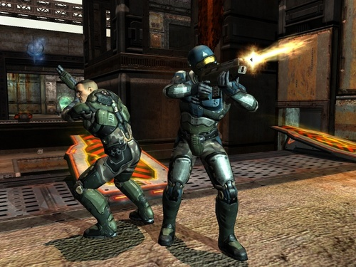
Uses in “real games”
Calculate aiming for the AI characters in Quake ?
To prevent them being too accurate (…and therefore unrealistic)
Network inputs:
Visibility (dark, foggy, bright)
Amount of target visible
Distance to target
Current weapon
Output
Radius of distance from centre of target (bigger radius = less accurate)

Slide 45
Some additional thoughts
In order to satisfy the fitness function many robot behaviours can emerge
Robot driving example
You can also train a network to classify data using an EA
Fitness function = total error

Slide 46
Evolving Neural Network Topology
As well as evolving weights, it makes sense to evolve topology as well
A very well known technique is called NEAT:
Neuro-Evolution of Augmenting Topologies
Starts by using a population of networks with minimal technology that grow in complexity
Generates neurons, connections, layers and weights
http://www.cs.ucf.edu/~kstanley/neat.html

Slide 47
NEAT genomes

Slide 48
NEAT Mutation operators

Slide 49
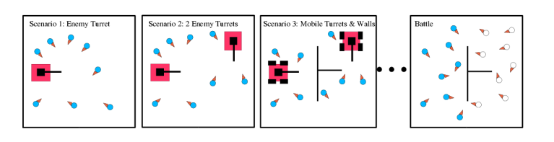
Example: NERO
Video
robot driving

Slide 50
Comparison of Training Methods
Backpropagation
Evolutionary Algorithm
Data needs to have input/output pairs
Need plenty of data
Careful data cleaning
Training and testing required
Lots of software packages available
Good when you don’t have training data in the form of input/outputs pairs
Careful design of fitness functions required
Lots of parameters: need to deal with EA parameters as well as NN design
Can be slow….

Slide 51
Practical
Evolving Minesweeper controller
Source Code and Executable supplied with initialisation file
Adapt topology and parameters by changing values in initialisation file
Conduct experiments to evaluate effect
Implement own evolutionary operators by modifying C++ Code
Selection
Mutation
Crossover
Other possibilities
Try different activation functions

Slide 52
Summary
We have looked at a number of uses of Neural Networks:
Classification
Prediction
Control
Training a network can be performed by backpropagation or using an evolutionary algorithm
Stochastic process in both cases
A lot of effort goes into cleaning and preparing data
Testing with unseen data very important

